Slide 1

Planet of the APIs
Ng Pan Yong
Chief Cloud Engineer
@pyx7b

Slide 2

title: Table of Contents
chapters:
- title: What are APIs
subChapters:
- title: Evolution of APIs
- title: OS API
- title: RPC
- title: Rise of the Web APIs
subChapters:
- title: SOAP
- title: REST
- title: The Others: WebSocket, GraphQL, gRPC
- title: Working with REST API
subChapters:
- title: OpenAI with Swagger
- title: curl
- title: postman
- title: API Rules the World
subChapters:
- title: The War of Stacks
- title: NodeJS
- title: FAST API
- title: In the End – United by API

Slide 3
What are APIs
Wikipedia:
An application programming interface (API) is a way for two or more computer programs to communicate with each other. It is a type of software interface, offering a service to other pieces of software.
Communicate
Program 1
Program 2
Software interface
Software interface
Service
Service

Slide 4

Evolution of APIs
The concept of API was conceived since the time of sub-routines
Term was conceived in 1968
At the lowest level APIs is the mechanism for interfacing with hardware
Goals of API:
abstraction
standardization
interoperability
Computer A
Computer B
Program 2
Program 3
Program 1
Operating System
Hard Abstraction Layer
Instructions sets
Hardware
Command line Interface
program == process

Slide 5
Operating Systems APIs
OS Level API such as Linux API and Win32 with kernel provides API to programs to access system resources such as file system, device driver, network, etc
#include <stdio.h>
#include <unistd.h>
#include <stdlib.h>
int main() {
pid_t child_pid = fork();
if (child_pid > 0) {
printf("Child process ID: %d\n", child_pid);
wait(NULL);
printf("Child process finished\n");
exit(EXIT_SUCCESS);
}
else {
exit(EXIT_FAILURE);
}
}
program == process
User Program Space
Linux API to perform system calls
Linux Kernel

Slide 6
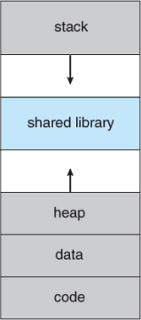
Libraries are not APIs
Program/Process
Memory Address Space
In Windows DLL (Dynamic Linked Libraries) are compiled code that can be loaded into the the user program memory address space to access OS API.
The equivalent in Linux is shared libraries e.g.libc, libssl
Linux\
systems calls
Link libraries are not considered APIs because they operate in the memory space of the program and it is the system calls that provides the interface to the underlying OS services

Slide 7
Remote Procedure Calls
Remote Procedure Calls (RPCs) are a mechanism that allows a computer program to execute code in a different memory address space, which may be on a remote machine. The basic idea behind RPCs is that a program can call a function or procedure in a different address space just as if it were a local function call.
Computer A
Form of inter-process communication
Can be used over different network protocols such as TCP, UDP, and HTTP
Requires the data to be serialized and deserialized for transfer over the network
Involves IDL (Interface Definition Language) for cross-platform integration. IDL define the methods, arguments, and return types of the remote procedure calls
Examples for RPC: Java RMI, CORBA, Thrift, Avro, protobuf
Computer B
Program 2
Func B
Program 3
Program 1
Func A
Func C
program == process

Slide 8
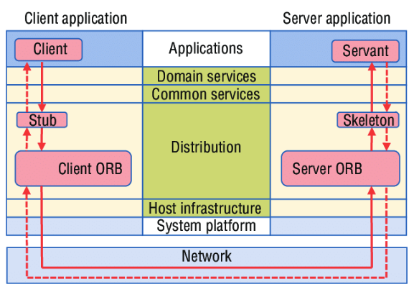
RPC Beware
Requires client to implement complex error handling mechanisms
Highly susceptible to the availability of a network and the remote service
Performance is highly dependent on the network latency between client and server
Compatibility issues with programming language and IDLs
JAVA RMI
CORBA
+-------------+ +-------------------+ +---------------+
| Java Client | | Java RMI Server | | Java Object |
--------------+ +-------------------+ +---------------+
| | |
| Remote Method Invocation | |
| (object serialization) | |
| ---------------------------> | |
| | Remote Object Reference |
| |-------------------------->|
| | |
| | Object Method Invocation |
| |-------------------------->|
| | |
| Remote Method Result |<--------------------------|
|<-----------------------------| |
| | |
IDL
serialization

Slide 9

RISE
of
the
Web APIs
Notes:
How API changes the world!

Slide 10
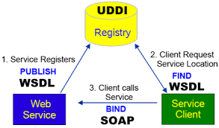
First Came SOAP Web Services
<?xml version="1.0" encoding="UTF-8"?>
<definitions name="Bookstore"
targetNamespace="http://example.com/bookstore"
xmlns="http://schemas.xmlsoap.org/wsdl/"
xmlns:soap="http://schemas.xmlsoap.org/wsdl/soap/"
xmlns:tns="http://example.com/bookstore"
xmlns:xsd="http://www.w3.org/2001/XMLSchema">
<types>
<xsd:schema targetNamespace="http://example.com/bookstore">
<xsd:element name="bookId" type="xsd:int"/>
<xsd:element name="title" type="xsd:string"/>
<xsd:element name="author" type="xsd:string"/>
<xsd:element name="price" type="xsd:float"/>
</xsd:schema>
</types>
<message name="getBookRequest">
<part name="bookId" element="tns:bookId"/>
</message>
<message name="getBookResponse">
<part name="title" element="tns:title"/>
<part name="author" element="tns:author"/>
<part name="price" element="tns:price"/>
</message>
<portType name="BookstorePortType">
…
Good: over standard HTTP protocol
Bad: dependant on XML which adds overhead including transformation & parsing.
Bad: WSDL like IDL, laborious to maintain
Ugly: UDDI global registry of web service concept failed to take-up

Slide 11
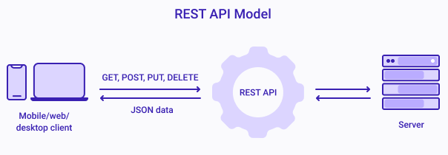
The Came RESTFul API
Uses a simple and platform independent set of HTTP methods interact with resources identified by URIs
Lightweight: use of JSON and scaled to handle large amounts of traffic.
Stateless: simplifies server-side development and allows for better scalability and fault tolerance
The term "REST" stands for "Representational State Transfer", which was coined by Roy Fielding in his doctoral dissertation in 2000
"Representational State Transfer" reflects the idea that a client can access and manipulate the representation of a resource (i.e., its state) through a standardized set of operations (i.e., transfer).
source: rlogica
Notes:
/

Slide 12
REST Example: Pet store
curl -X 'GET’ 'https://petstore.swagger.io/v2/pet/findByStatus?status=available’ \
-H 'accept: application/json'
curl -X 'POST' 'https://petstore.swagger.io/v2/pet’ \
-H 'accept: application/json’ \ -H 'Content-Type: application/json’ \
-d ‘{
"id": 0,
"category": { "id": 0, "name": "string" },
"name": "doggie",
"status": "available"
}'
https://petstore3.swagger.io
Notes:
/

Slide 13
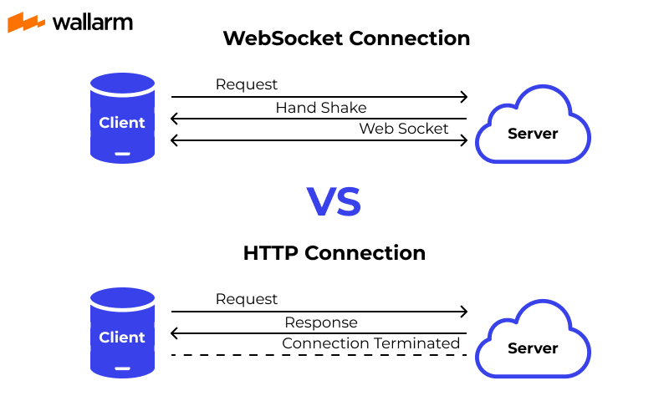
Going 2-way: Web Socket
Enable two-way communication between a client and a server over a single, long-lived connection.
For real-time applications
Allow binary data transfer
Supported in most modern web browsers using the WebSocket API, which is part of the HTML5 specification.
>> Do not be confused with web hook which a one-way server-to-client typically for notifications
Notes:
/

Slide 14

GraphQL is an open-source query language and runtime for APIs developed by Facebook.
Defines a schema that provides a strongly-typed interface for client
Unless REST, allow clients to specify exactly what data they need
Aggregate multiple resource requests in a single query
Subscriptions: for client to receive notifications for data modifications
Mutations: apply data modifications to resources
query {
pets(species: "Cat", age_lt: 3) {
id
name
age
breed
}
}
Notes:
/

Slide 15

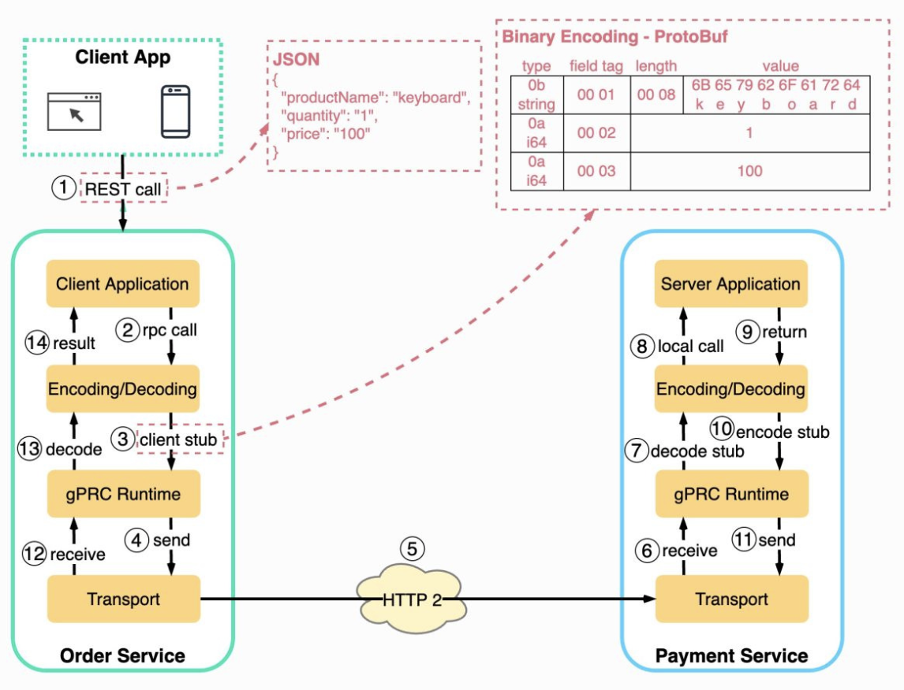
RPC is dead, Long Live gRPC
gRPC is a high-performance, open-source framework originally developed by Google.
Communicate over HTTP/2 or TCP, using a binary serialization format called Protocol Buffers.
More commonly used for communication between micro-services
Some adoption on mobile client

Slide 16


Working with REST APIs

Slide 17
API Design Principles
Resilient | Stateless distributed computing and incorporate error handling, time-outs and monitoring.
Abstraction | Course grain API that provides functionality with abstraction away implementation details
Maintainable | Version control, flexible to change, keep things simple, intuitive and well-documented.
Performant | Loose-coupling and asynchronous communication to improve the responsiveness and scalability of the API. Use caching to reduce network round-trips.
Secured | Encrypted communication, authentication & authorisation, data validation, security best practices.
Notes:
PMAPRS

Slide 18
Use JSON
{
"employees": [
{
"Name": "John Doe",
"Active": true,
"age": 30,
"jobTitle": "Software Engineer"
},
{
"Name": "Jane Smith",
"Active": true,
"age": 25,
"jobTitle": "Web Developer"
},
{
"Name": "Bob Johnson",
"Active": true,
"age": 40,
"jobTitle": "Project Manager"
}
]
}
JSON stands for JavaScript Object Notation. It is a lightweight data interchange format that is easy for humans to read and write, and easy for machines to parse and generate. it is language-independent.
Useful Links:
https://quickref.me/json.html
https://jsoneditoronline.org
https://codebeautify.org/jsonviewer

Slide 19
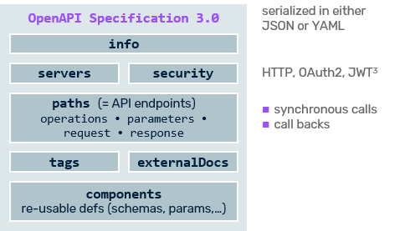
Specify with OpenAPI/Swagger
Open-source specification for building, documenting, and consuming RESTful APIs.
Host API on SwaggerHub
Online Editor
Download APIs, Documentations and SDKs
VSCode Extension from 42crunch for API Security
Notes:
/

Slide 20
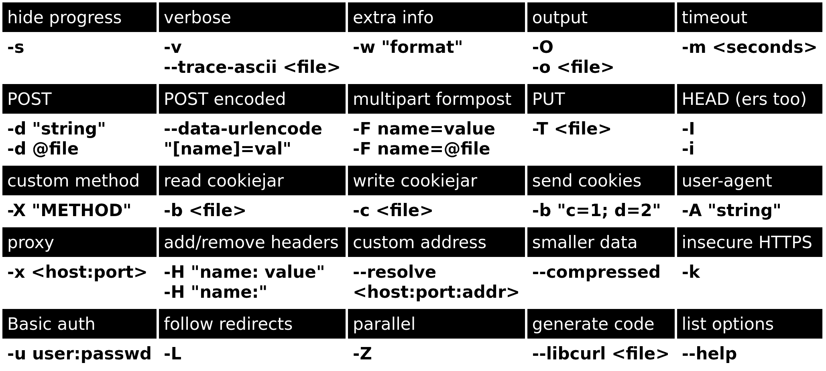
Know curl://
curl is a command-line tool used to transfer data to or from a server using various protocols, including HTTP, FTP, SMTP, POP3, and many others.
https://quickref.me/curl
Powershell (pwsh)
PS C:\> Invoke-WebRequest
Notes:
I want you to act as a Linux terminal. I will type commands and you will reply with what the terminal should show. I want you to only reply with the terminal output inside one unique code block, and nothing else. Do not write explanations. Do not type commands unless I instruct you to do so. When I need to tell you something in English I will do so by putting text inside curly brackets {like this}. My first command is pwd.

Slide 21

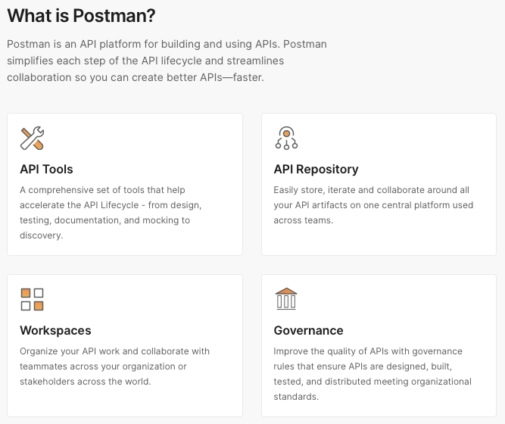
Postman
www.postman.com
Great tool for testing APIs
Sign-up for free
Download Clients
Notes:
/

Slide 22

API Rules the World

Slide 23
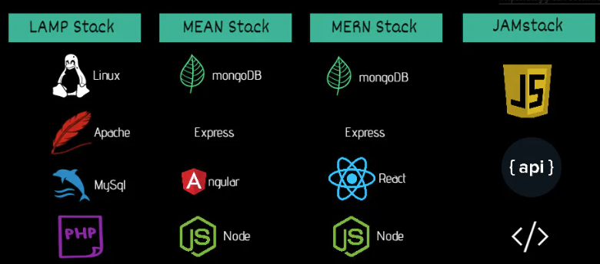

The War of Stacks
OSS, CMS, Web2.0
AJAX, Mobile responsive, Single Page Applications
Headless CMS
https://blog.greenroots.info/jamstack-for-all-an-introduction
Notes:
/

Slide 24
NodeJS & Express
NodeJS is an open-source, cross-platform server based on JavaScript runtime. It uses an event-driven, non-blocking I/O model that allows it to handle multiple requests simultaneously with minimal resources.
Express is Web Framework that runs on Node.
Get Started
Download and install Node
Ask ChatGPT to create an express API server that has 1 get method for retrieving pet by id and and 1 post method to add new pet
Create project
Install NPM packages
Cut and paste code
Start Server

Slide 25
FastAPI
FastAPI is a modern, fast (hence the name), web framework for building APIs with Python. It is designed to be easy to use, high-performance, and to provide automatic validation of request date & automatically generate OpenAPI documentation
Get Started
Create a project folder with virtual environment
Ask ChatGPT to write an api server using fast API for a book store with 5 books preloaded
Run the code on uvicorn
Check out the docs
Call OpenAI API

Slide 26
In the End: United by AI
APIs provides abstractions to allow different technologies to be integrated, consuming services to create multiplying effect
Shift thinking to – “How can others consume my service?”
End User Devices
AI/ML Models
Drones & Robots
LLM
Capability shared with a network connected via APIs
Quantum Computing Power
Digital Services
Cloud Resources
Scientific Sensors
Digital Sensors

Slide 27

Thank You

